Slide 1
IT Identity and IS Relational Switching Cost in the Context of Post-Merger Integrations
Sam Senanayake Supervised by Assoc Prof. Petros Chamakiotis

Slide 2
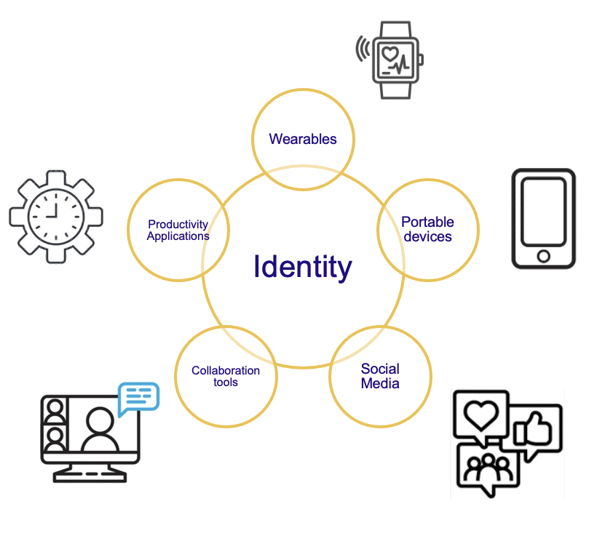
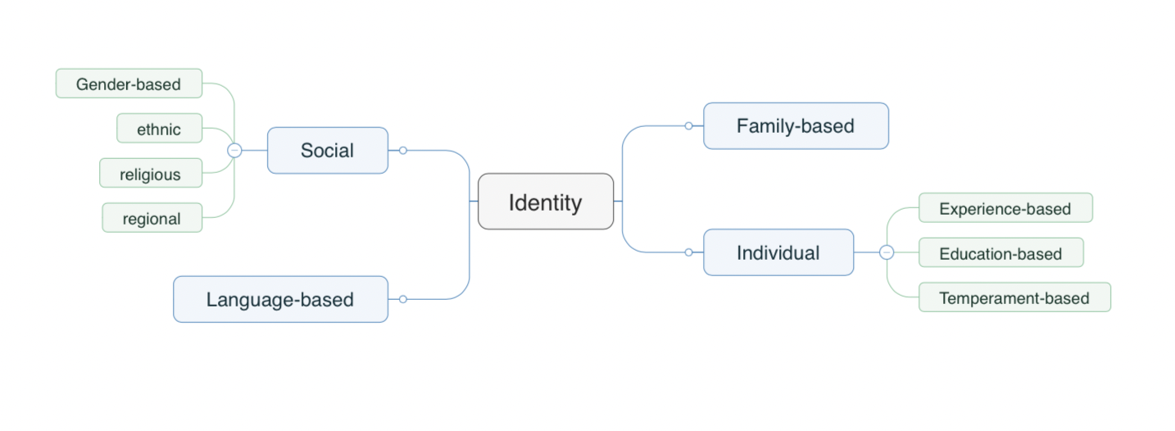
Introduction
Identity Concepts
Identity: We derive our identities from our interactions and communications within society through our shared use of symbols (Stets & Burke, 2000)
Multiple identities: Individuals develop and maintain multiple identities (James, 1890). Identities that are more important to the self weigh more prominently and tend to influence behavior than less important identities (McCall & Simmons, 1978)
IT Identity (ITID): The study of the interplay between identity and Information Technology (IT) systems … the extent to which an individual views the use of IT as integral to his or her view of self (Carter and Grover, 2015)

Slide 3
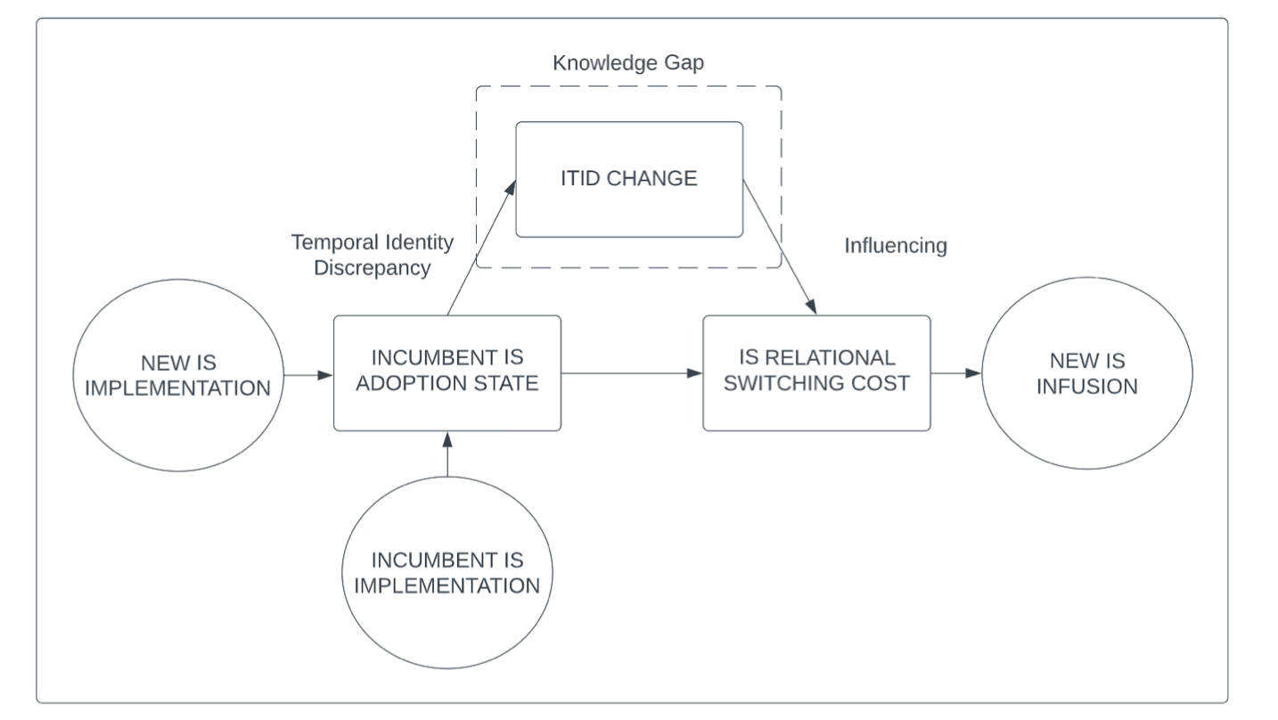
Research Motivation
How does IS switching interact with IT Identity?
Gap: The effects of information workers adopting a new IS and establishing a linkage between IS implementations on ITID (Hassandoust, 2017). IS usage can be observed on a continuum, not only through the current IS implementation, but across overlapping IS implementations.
IS Switching Costs: Play a central role in increasing user resistance in the context of implementing a new enterprise system and further mediate the relationship between other antecedents for IS implementations (Kim & Kankanhalli, 2009).
Goal: Exploring how potential switching costs encountered by information workers moving off an existing incumbent IS and how this impacts ITID.
Notes:
Main question : What interesting thing is unknown that the authors set out to learn more about?

Slide 4
Research Design
Qualitative Study
Research Timeline
Question: If an employee established an ITID in relation to an incumbent information system, does the act of moving to a new IS result in a disruption of their current ITID?
Qualitative Case Study*: Inductive and interpretive approach using Reflexive Thematic Analysis (Braun & Clarke 2016). Two organizations experiencing M&A activity following similar contexts (industry, deal size, organization size and complexity)
Post Merger Integration (PMI) Context: PMI is a phase of the Corporate Mergers and Acquisitions (M&A) lifecycle where IS Switching is frequently conducted as a source of extracting merger synergies (Alaranta, 2005; Giacomazzi et al., 1997; Graebner et al., 2010; McKiernan & Merali, 1995)
Phase 1: Screening Survey (June 2023)
Goal: Identity a case organization and participants: IS workers who have experienced IS switching as part of PMI
Measurements: Validate ITID baseline and development of interviews
Phase 2: Semi-structured interviews (Aug 2023)
2 Rounds x 10-15 participants
Phase 3: Analysis and submission (Sept 2023)
Thematic Analysis iterates during data gathering
Present Preliminary findings at a notable conference
*Part 2: Comparative Case Study in 2024

Slide 5
Implications and Conclusion
Extending the realm of ITID
Proposed Theoretical Contributions: There is an opportunity to contribute to the extant literature on IS implementations in the workplace through the theoretical lens of ITID, by incorporating the concepts of IS Relational Switching Costs by including IS Switching costs as an additional factor influencing IS Infusion behaviors and by expanding the contexts of constant interactions with IT to include IS switching behavior.
Proposed Practical Implications: This work has the potential to assist managers and organizations in mitigating the resistance to IS adoption during through a deeper understanding of the interaction between IS and ITID during IS implementations.

Slide 6
Q&A

